Slide 1

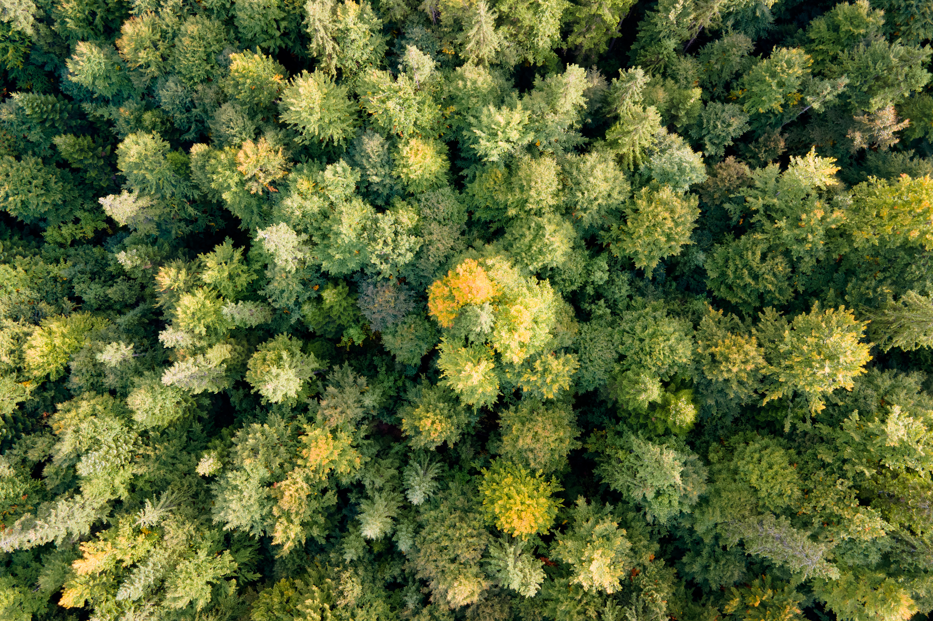




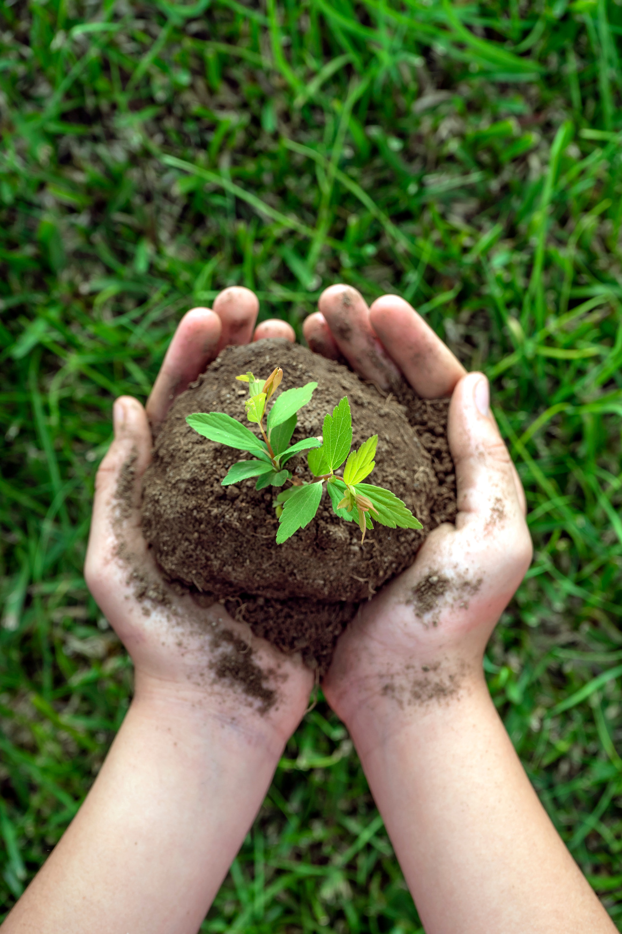
AI-BASED SOLUTION FOR ADDRESSING PLANT DISEASES IN EGYPT'S FRUIT AND VEGETABLE CROPS
Turning Small Steps into Big Impact
Supervised by:
Dr. Mahmoud Bassiouni
Assistant Supervisor: Eng. Toka Ashraf

Slide 2


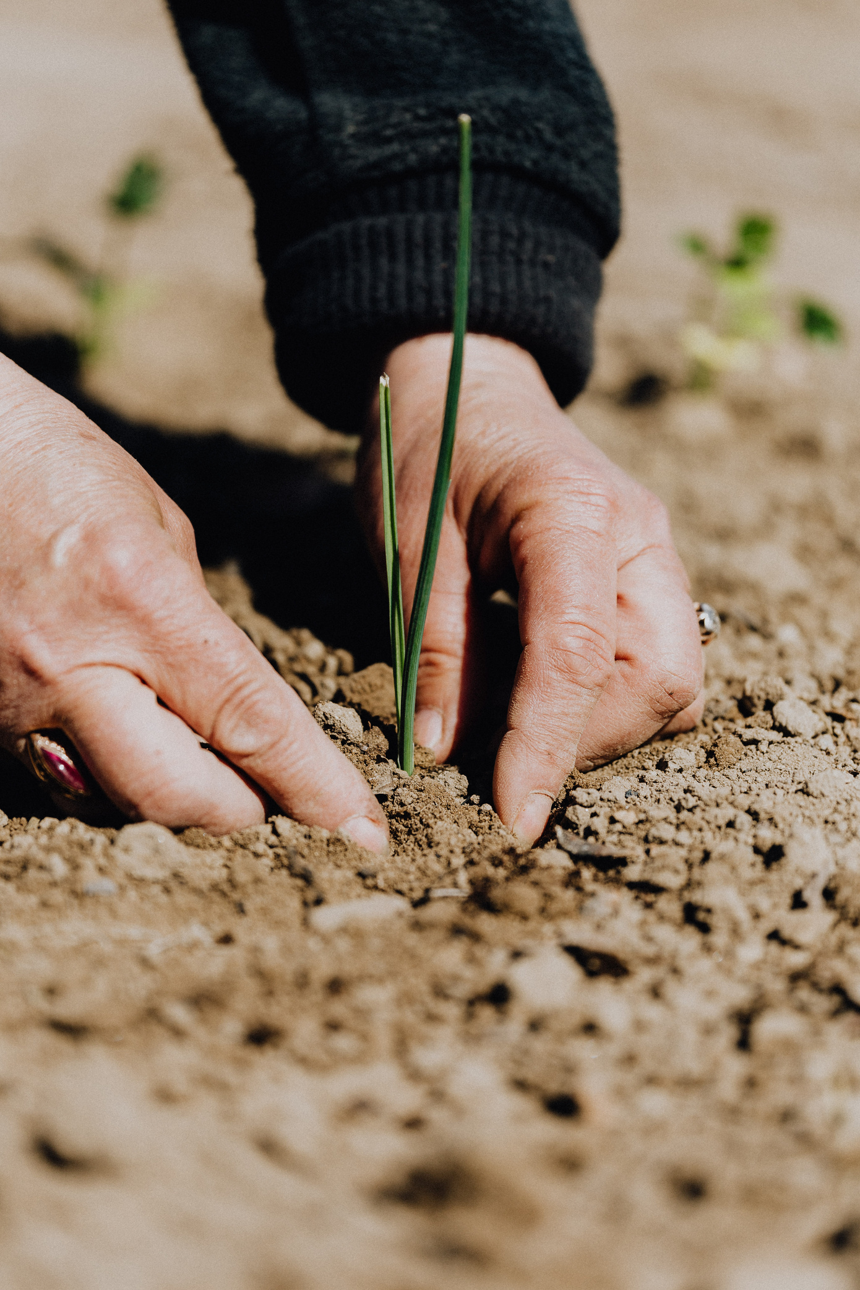
Team Members
Introduction
Tabel of Contents
Problem Defination
Motivation
Literature Review
Objective
System Input & Output
System Design
Datasets
Visualization
AI Models (1,2,3)
Demo of App
Future Work
Refrences
Conclusion
Thank you

Slide 3
OUR TEAM
Kholoud Mohsen 21-00882
MORGAN MAXWELL
Eslam Ayman 21-01854
Team_Leader
Bishoy Ezzat 21-00584
MARIANA NAPOLITANI
George Hany 21-00724
MARIANA NAPOLITANI
Hager Abdelqader 21-02131
Mariam Hany 21-01011
SASCHA DUBOIS
Farah Mohamed 21-00686

Slide 4

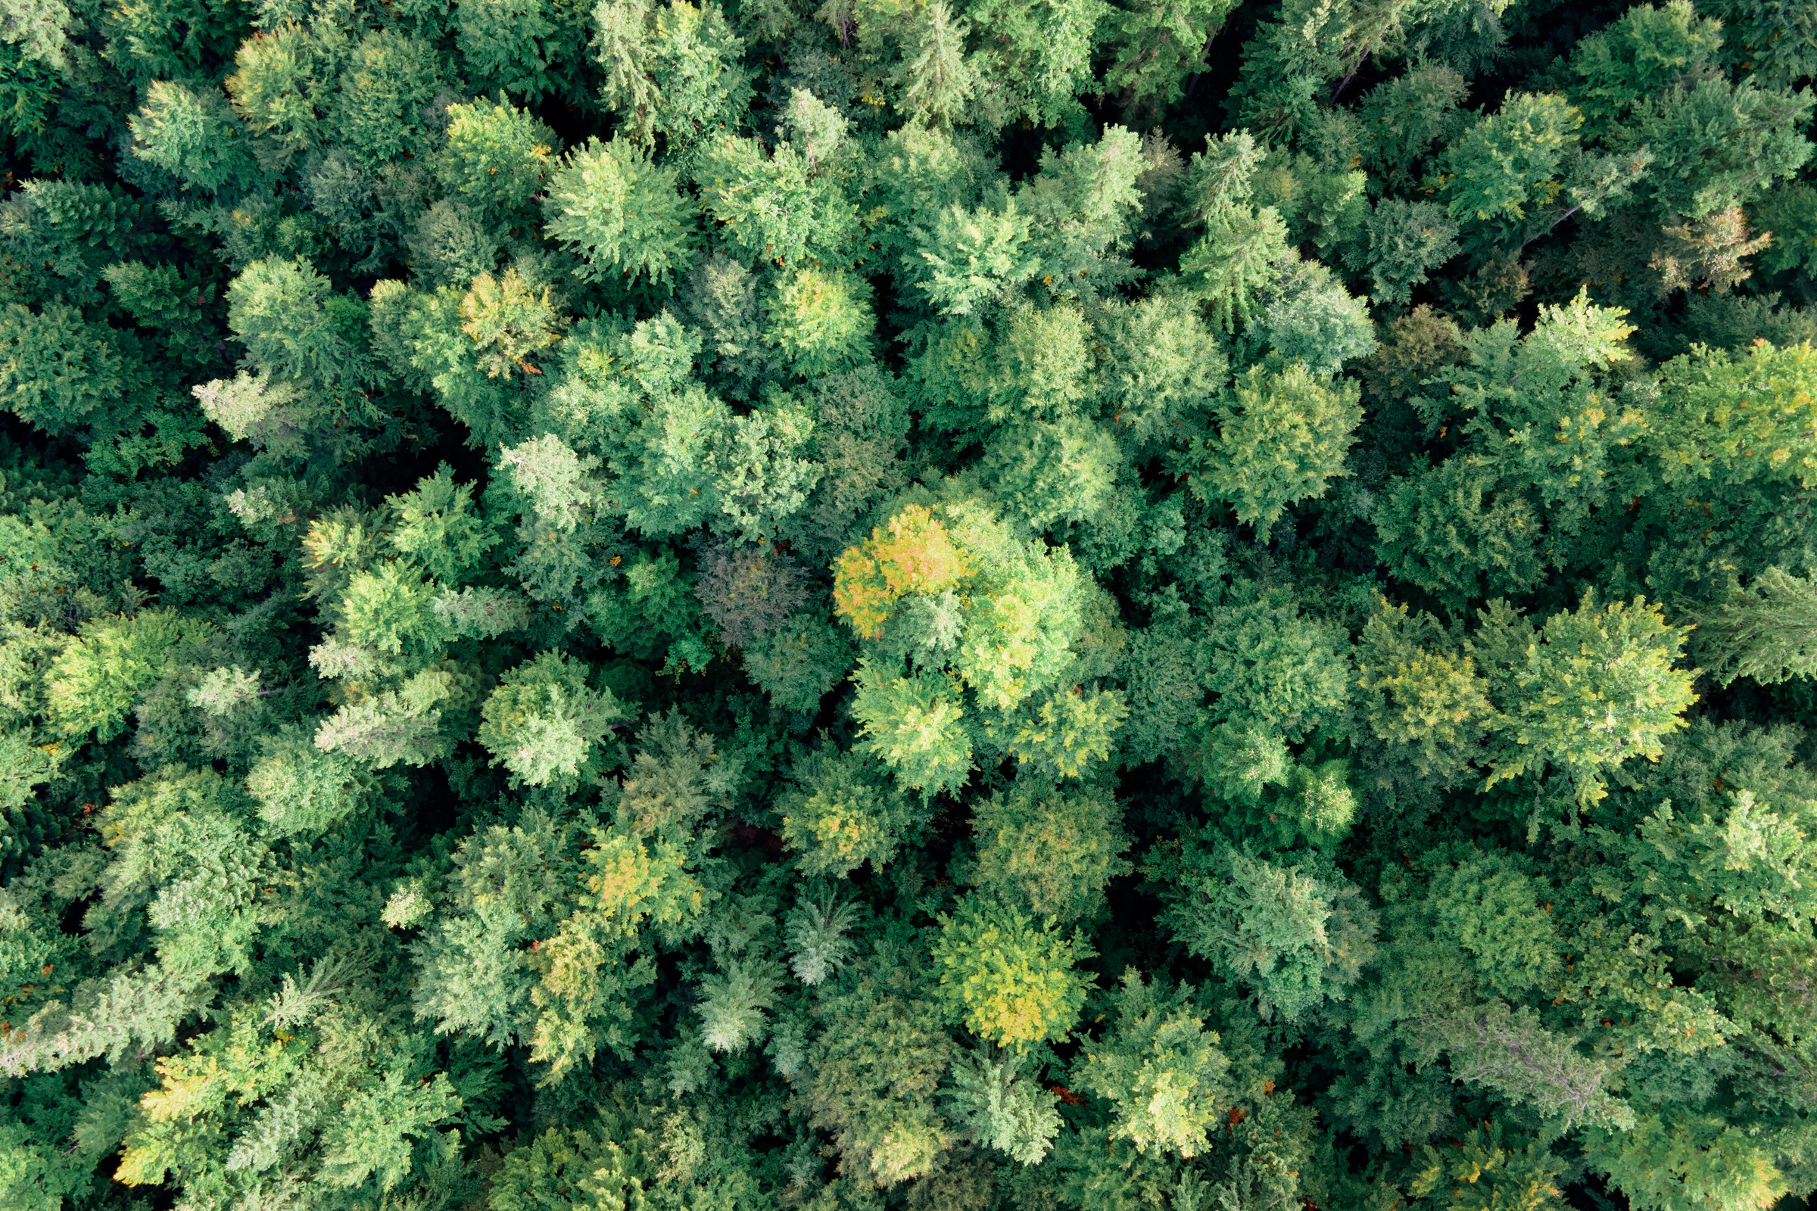


Introduction – Importance of Agriculture
Agriculture is a vital pillar of global stability and development. It plays a key role in:
Ensuring food security for growing populations
Providing income and employment for rural communities
Driving economic growth, especially in developing nations
Supporting sustainable use of natural resources
Reducing poverty and strengthening community resilience
However, the agricultural sector faces major challenges such as:
Plant diseases & right tratment
Climate change
Water scarcity
Soil degradation
Limited access to expert support and technology

Slide 5

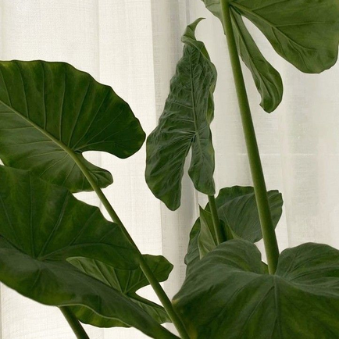




Proplem Defination
Planty Care focuses on three major problems farmers struggle with:
Disease diagnosis: Similar symptoms make it hard to detect the correct disease, leading to wrong or late treatment.
Fertilizer choice: Without soil insight, farmers use unsuitable fertilizers, harming crop health and soil quality.
Crop selection: Poor crop-soil matching leads to low yield and wasted effort.
Planty Care solves these issues using real-time, AI-powered support through a simple mobile app.

Slide 6
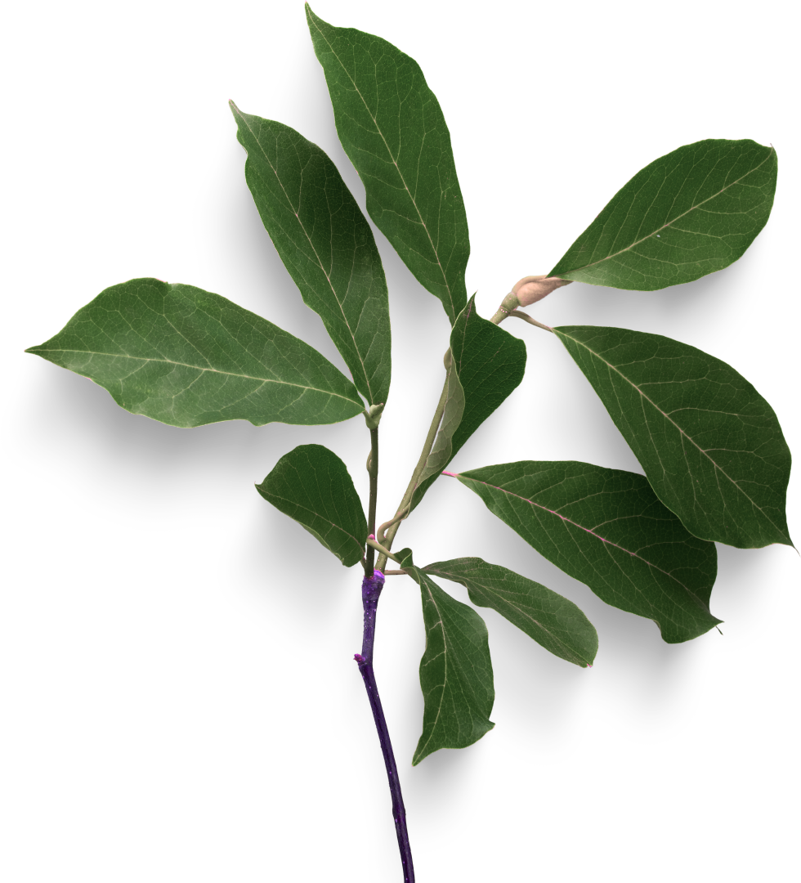
Motivation
Agriculture is Egypt’s Lifeline, a major contributor to Egypt’s GDP.
With Egypt experiencing losses exceeding 20%
20–40% of global crop loss is caused by plant diseases (FAO).
Over 500 million small-scale farmers worldwide lack access to expert advice.
Misuse of fertilizers reduces soil quality and increases production costs.

Slide 7
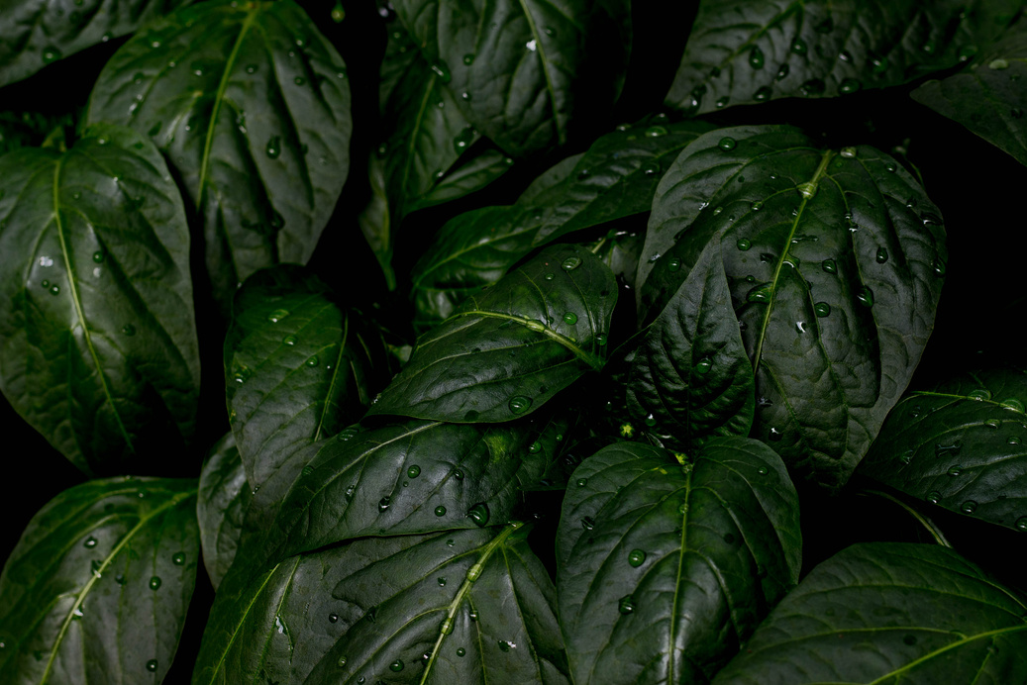
Literature Review
Author & Year | Dataset | Methodology | Accuracy
 | PlantVillage dataset
 | PlantVillage dataset | novel time‑effective CNN architecture, described as an energy‑efficient convolutional network (5× faster than Inception V3 and 2× faster than VGG19)
Bouacida et al. 2024
small Inception model architecture
94.04%
Biswas et al. 2024
95.17%
Naveed et al. 2025
PlantVillage dataset
ResNet18
93%

Slide 8

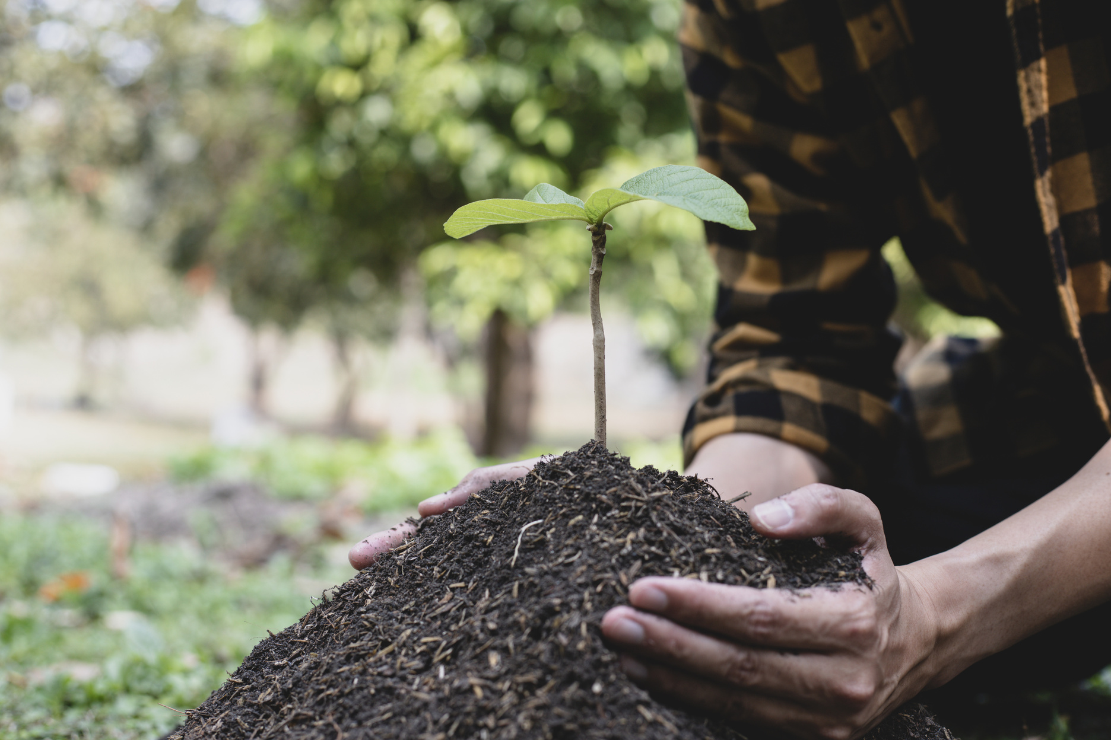
Objectives
Detect plant diseases & treatment using AI (ResNet-50)
Recommend the best crop using random forest
Suggest suitable fertilizer using XGBoot
Deliver all features through a developed Android mobile app (Java-based)
5.Data Security & Privacy Protection – Keeps user data safe

Slide 9
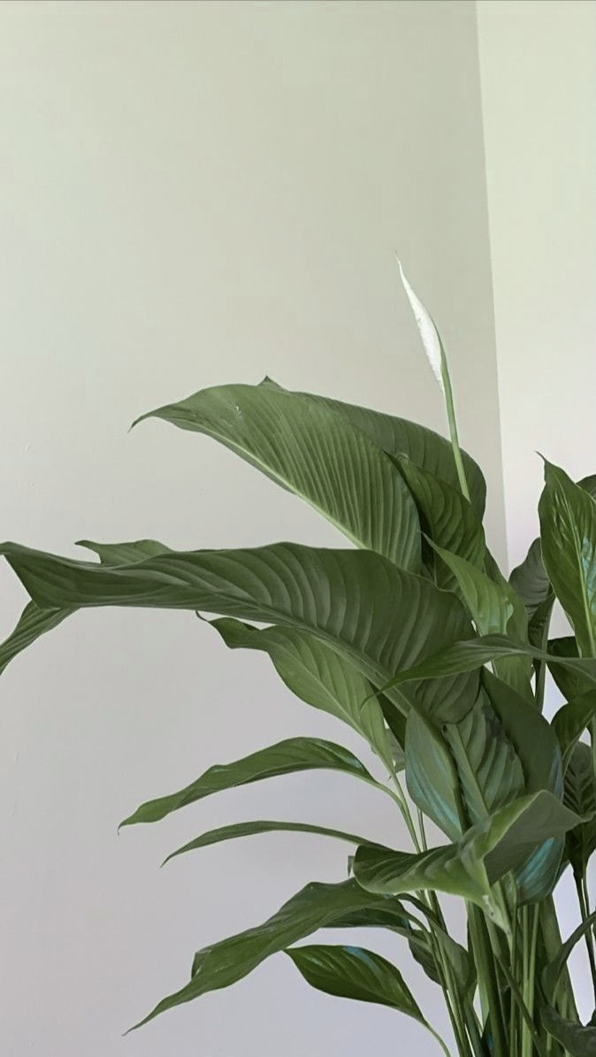
System Input & Output
Feature 1: Diseases Detection & Treatment Suggestion
Feature Input (Expected Input):
(single image)
Feature Output (Expected Output):
Disease Name
Description
Preventive measures and treatment tips
Suggested Supplement
Feature 2: Crop Recommenadtion System
Feature Input:
Environmental data (temperature, rainfall, N ,P)
Feature Output:
Most suitable crop(s) for the given conditions
Feature 3: Fertilizer Recommendation System
Feature Input:
Soil information (N, P, K levels, pH, soil color)
Selected plant (crop name)
Feature Output:
Best matching fertilizer for the selected crop and soil condition

Slide 10
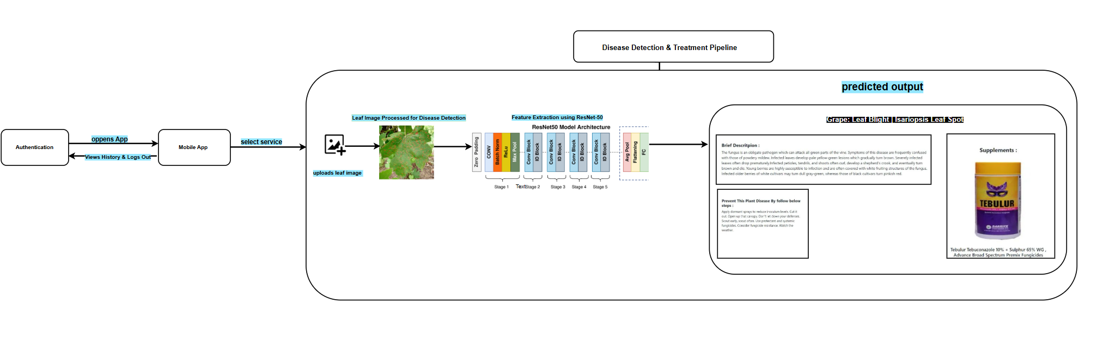
System Architecture Phase 1

Slide 11
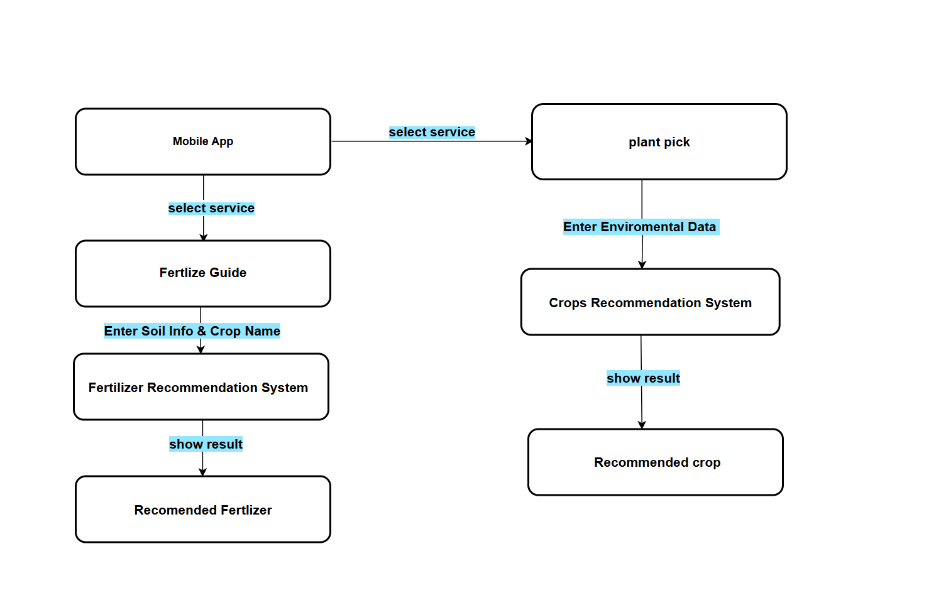
System Architecture Phase 2 Crop & Fertlizer guide

Slide 12
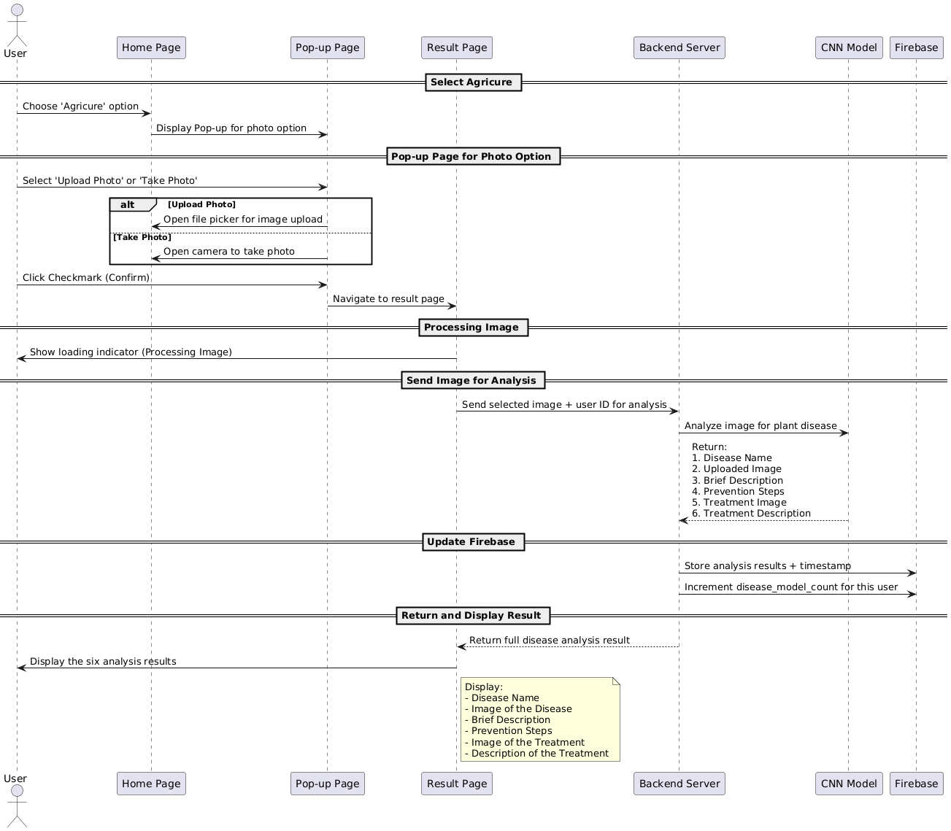
Sequence Diagram for Plant Disease Detection Feature

Slide 13
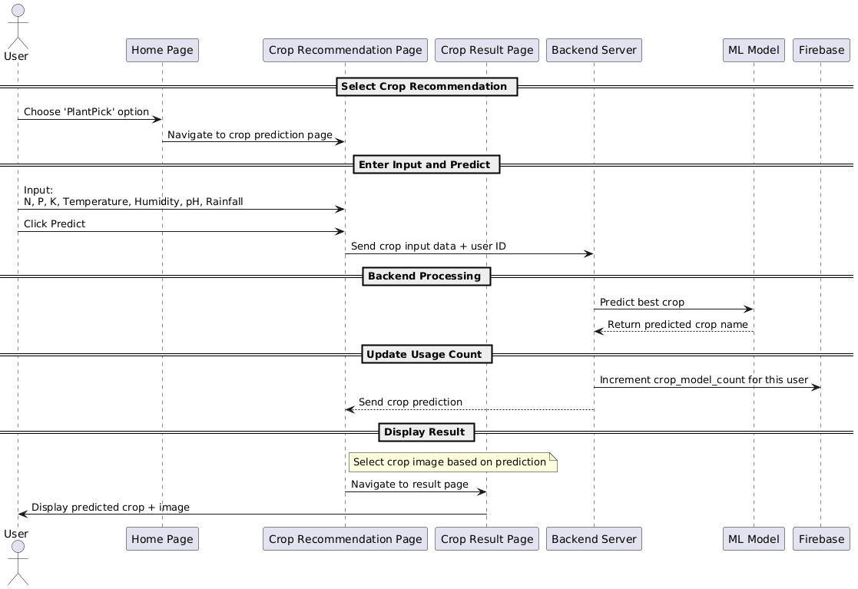
Sequence Diagram for Crop Recommendation Feature

Slide 14
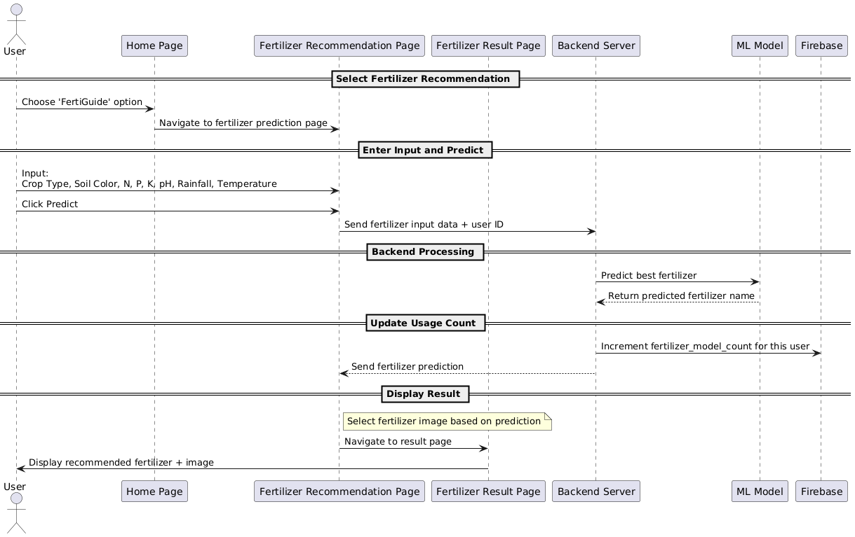
Sequence Diagram for Fertilizer Prediction Feature

Slide 15


DATASETS
In this project we used 3 datasets:
1- New plant disease dataset (images).
1.1- supplement_info(csv).
1.2- disease_info(csv).
2- Crop Recommendation dataset(csv).
3- Crop and fertilizer dataset(csv).

Slide 16
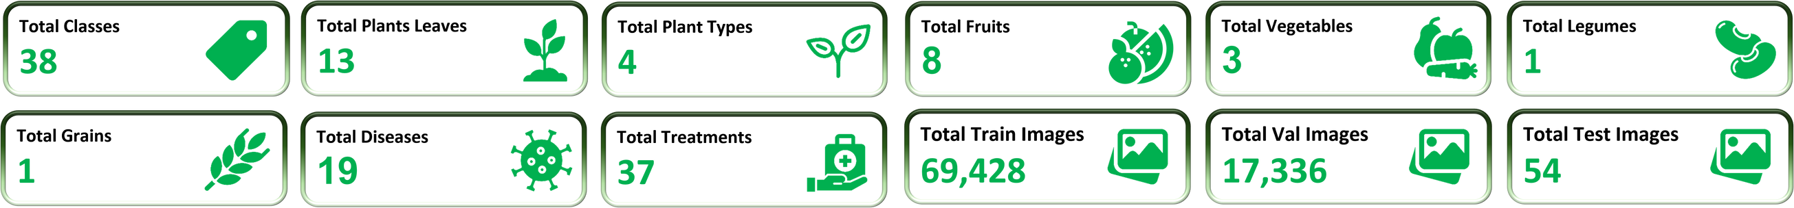
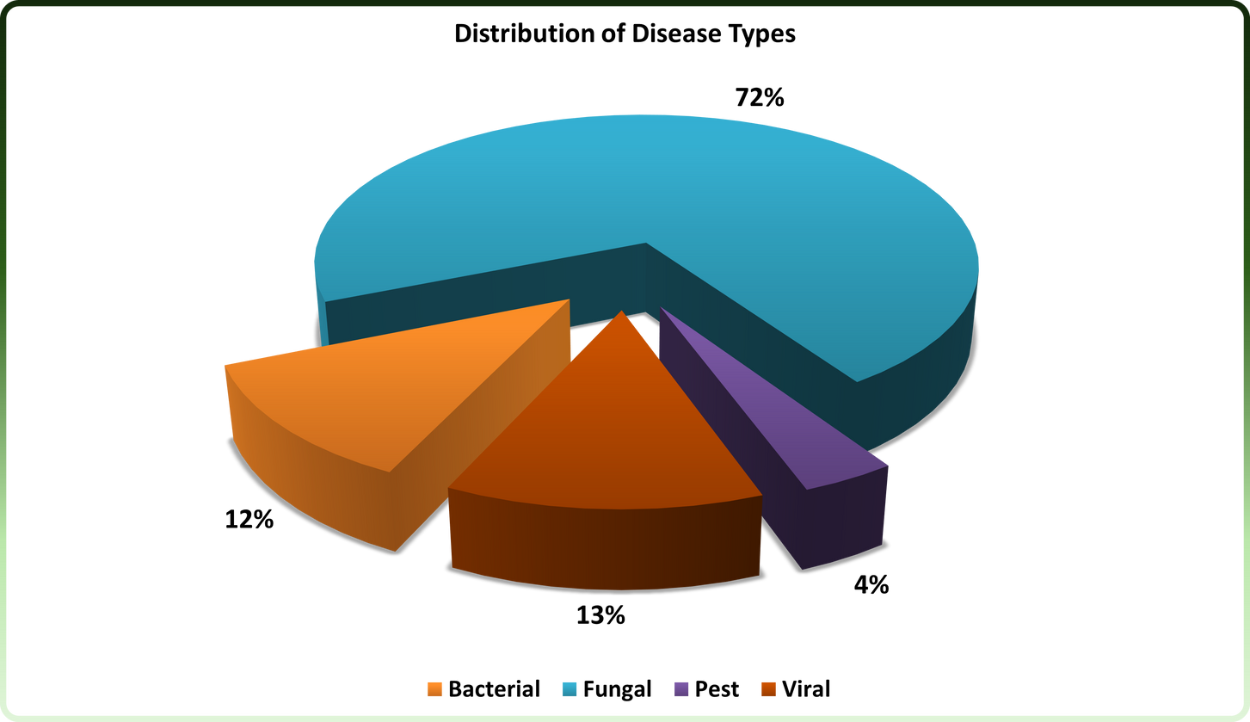
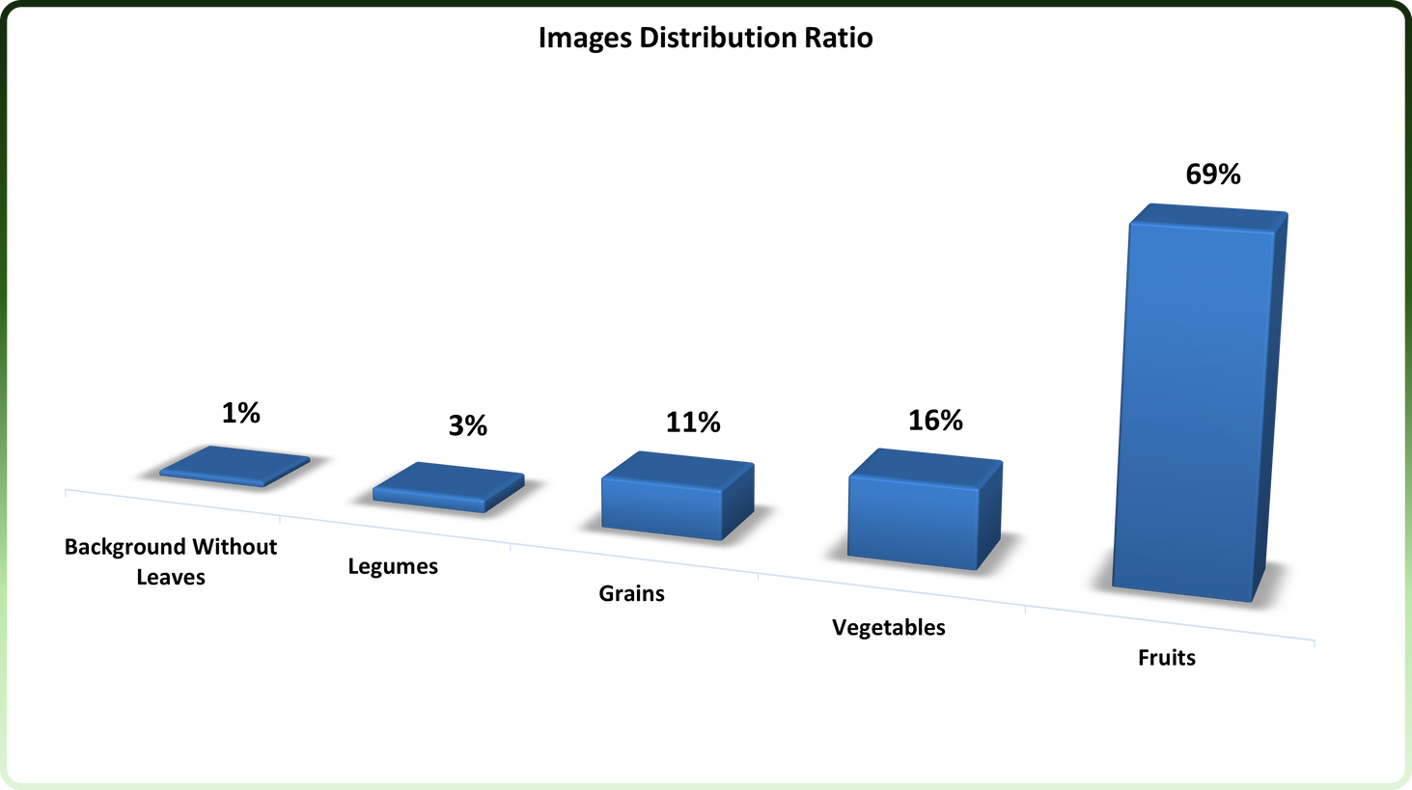
Visualization of Plant Disease Dataset
Distribution of Disease Types
Images Distribution Ratio

Slide 17
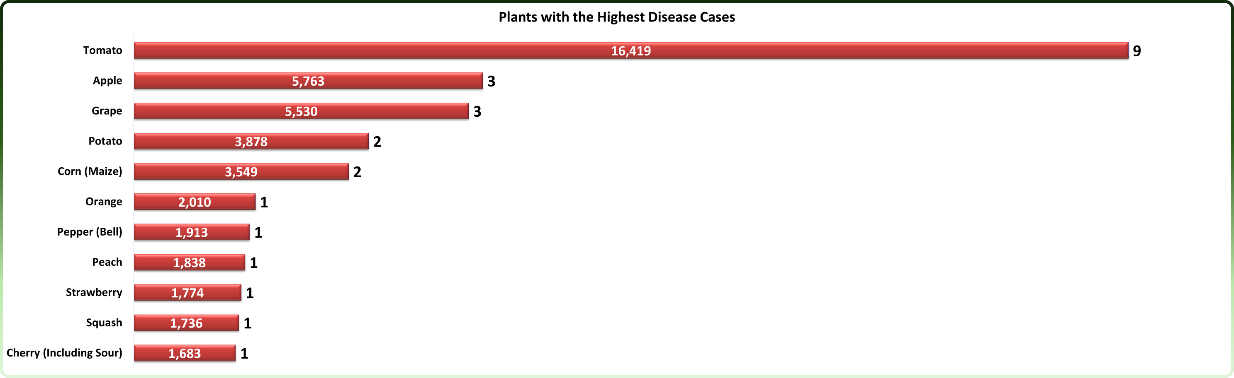
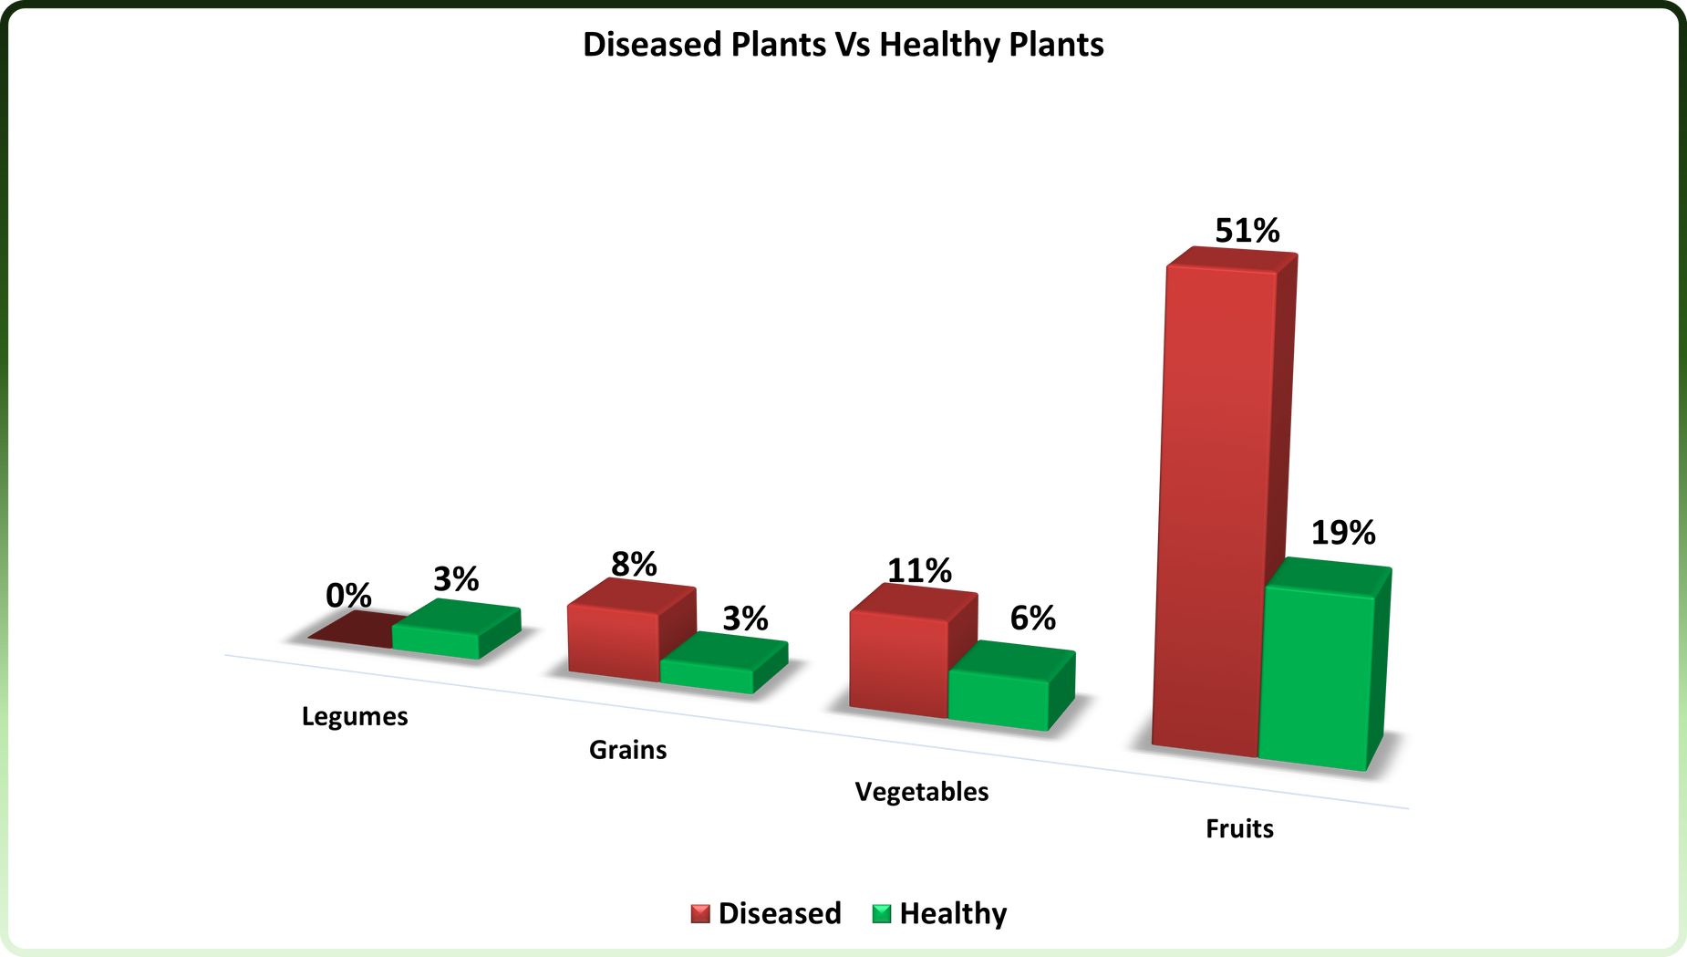
Visualization of Plant Disease Dataset (Cont.)
Plants with the Highest Disease Cases
Diseased Plants Vs Healthy Plants

Slide 18


Feature 1 : Plant Disease Detection
🗂 Dataset Overview (New Plant Diseases Dataset)
Source: Kaggle
Size: 86,818
Classes: 38 (includes healthy and diseased leaf categories)
Crops Covered: Tomato, Potato, Corn, Apple, etc.
Split:
Training: 69,428
Validation: 17,336
Testing: 54
Train / Validation / Test Split: 80% / ~19% / ~1%
Image Size: Resized to 128×128 pixels
✅ Purpose: Used for image-based classification of plant health conditions.
📚 Supporting Dataset (Plant Disease & Supplement Info Dataset)
Includes:
Disease name
Symptoms description
Treatment steps
Reference image URLs
Goal: Provides educational feedback and actionable treatment recommendations post-diagnosis.

Slide 19


Common Plant Diseases in Egypt
Corn – Cercospora leaf spot Gray leaf spot, Common rust, and Northern Leaf Blight, which lower grain quality .
Tomato – Prone to late blight, bacterial spot, and early blight, leading to fruit rot and reduced production.
Grapes – Affected by downy mildew, powdery mildew, and black rot, causing poor fruit quality and yield loss .

Slide 20



Model 1 : ResNet-50 Implementation
ResNet-50
Algorithm: ResNet-50 (Deep Convolutional Neural Network)
Architecture: 48 conv layers, MaxPooling, AvgPooling, and fully connected layers
Key Feature: Uses residual blocks to solve the vanishing gradient problem, allowing deeper and more stable training
Purpose: High-accuracy classification of plant diseases from leaf images
⚙️ Training Details
Activation Function: Softmax
Optimizer: AdamW (learning rate: 0.001)
Reproducibility: Random seed set for consistent training results

Slide 21
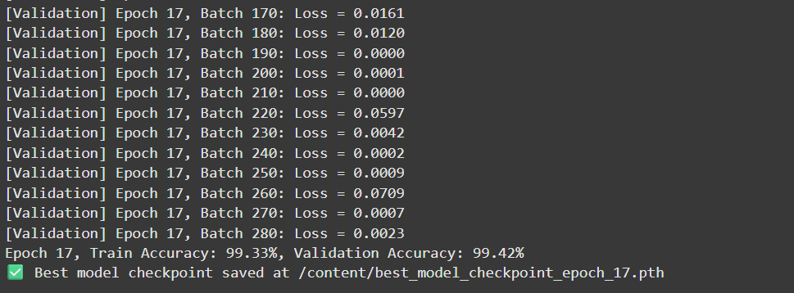
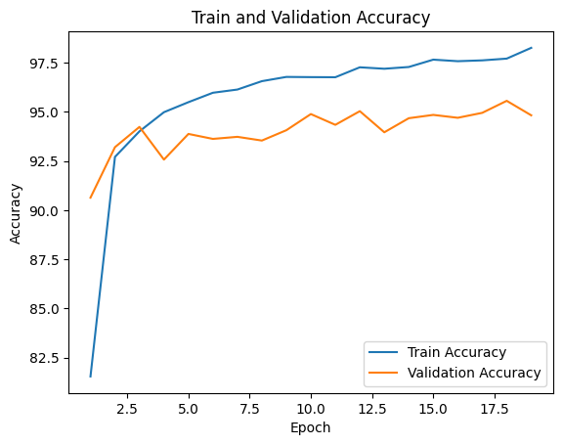
Model 1 : ResNet-50 Results
Epoch 17, Train Accuracy: 99.33%, Validation Accuracy: 99.42%

Slide 22
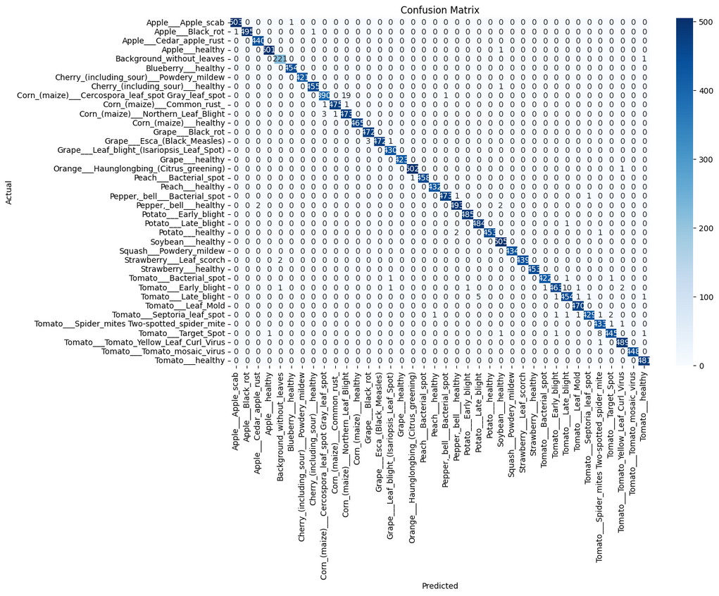
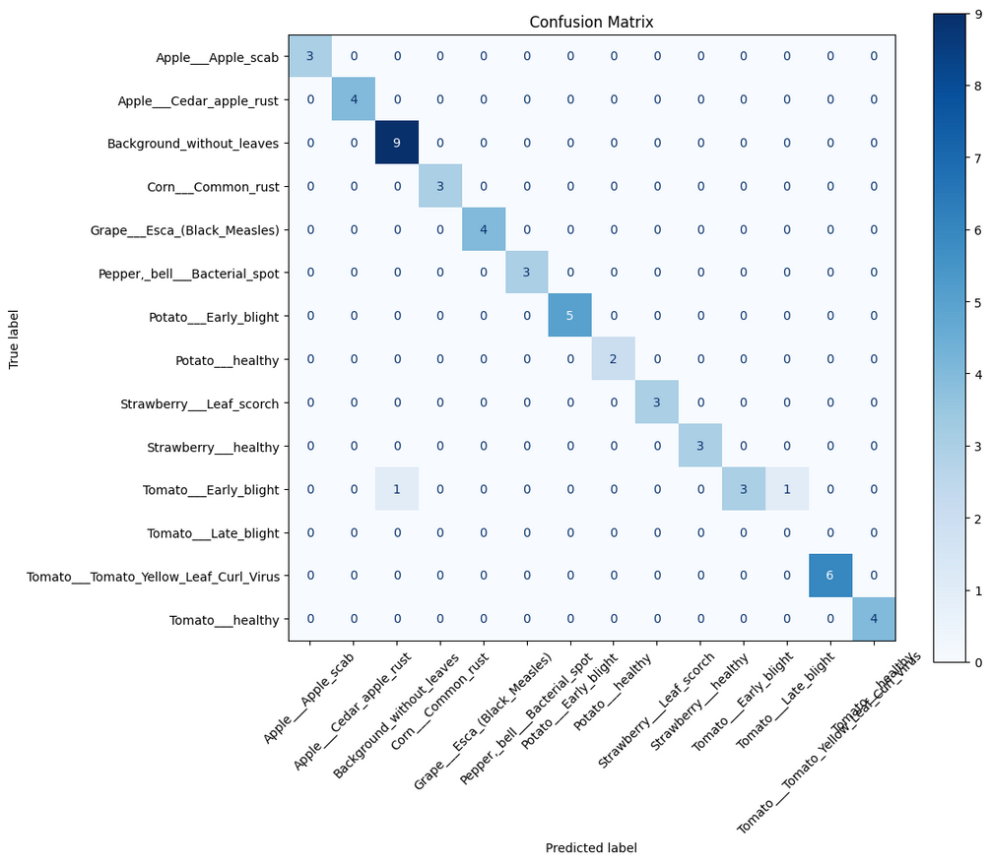
Model 1 : ResNet50 Results (Cont.)
test confusion matrix
validation confusion matrix
Average Validation Loss: 0.0191
Validation Accuracy: 99.42%
Test Accuracy: 96.30%

Slide 23
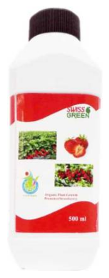
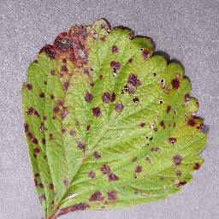


Here We Show Inputs And Predicted Outputs
Strawberry Leaf scorch
Breif Description
Prevent This plant disease
by follow below steps
Supplements :
Leaf scorch symptoms are very similar to the early stages of common (Mycosphaerella) leaf spot, with irregular dark purple spots being scattered over the upper leaf surface. As the spots enlarge, they begin to look like drops of tar, and are actually the accumulations of black fruiting bodies (acervuli) of the fungus. The centers of the spots remain purple (in Mycosphaerella leaf spot they are white) and there is no well-defined lesion border. In heavy infections, these regions coalesce and the tissue between the lesions often takes on a purplish to bright red color that is dependent on cultivar, temperature, or other factors. The leaves eventually turn brown, dry up, and curl at the margins giving the leaf a scorched appearance. Examination of the acervuli and conidial morphology can help to distinguish between leaf spot and leaf scorch at this advanced stage of disease. On the upper leaf surfaces of leaf scorch lesions, the acervuli are dark with glistening spore masses and dark apothecia. Petiole lesions are elongate, sunken, with a purplish to brown color and can kill the leaf by girdling the petiole. Runners, fruit stalks, fruit and caps can also become infected. Plants may become weakened and the number and vigor of crowns reduced. Infection predisposes the plants to winter and drought stress. In severe infestations, flowers and fruit may die.
"While leaf scorch on strawberry plants can be frustrating, there are some strategies which home gardeners may employ to help prevent its spread in the garden. The primary means of strawberry leaf scorch control should always be prevention. Since this fungal pathogen overwinters on the fallen leaves of infected plants, proper garden sanitation is key. This includes the removal of infected garden debris from the strawberry patch, as well as the frequent establishment of new strawberry transplants. The creation of new plantings and strawberry patches is key to maintaining a consistent strawberry harvest, as older plants are more likely to show signs of severe infection.",
SWISS GREEN ORGANIC PLANT GROWTH PROMOTER STRAWBERRY Fertilizer
To Check The Model
Input
Output
invalid

Slide 24
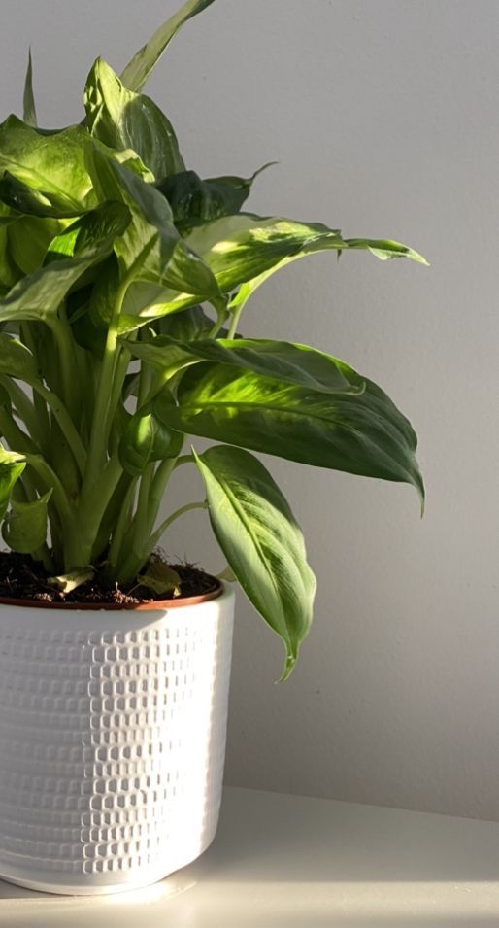
Feature 2 : (Crop Recommendation)
📊 Dataset Overview
Name: Crop Recommendation Dataset
Size: 2,200 instances (1540 train,594 val,66test)
Features (7 total):
Soil nutrients: Nitrogen (N), Phosphorus (P), Potassium (K) [kg/ha]
Climate factors: Temperature (°C), Humidity (%), Rainfall (mm)
Soil pH
Target: Multi-class classification (e.g., rice, maize, cotton, etc.)
Split: 70% training – 27% validation - 3% testing
Algorithm: Random Forest (Ensemble Machine Learning Model)
used Gradsearchcv To get best parameters
Why Used:
High prediction accuracy
Handles complex and varied environmental data
Robust under different farming conditions

Slide 25

Model 2 : Random Forest Results
Gradsearchcv Result:
criterion: entropy
max depth : 10
min samples leaf: 2
min samples split: 10
n_estimators :200

Slide 26
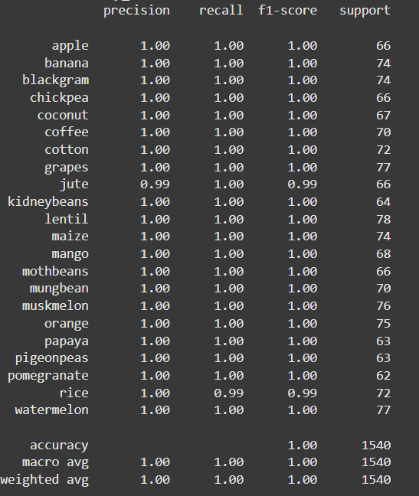
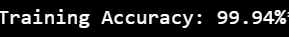
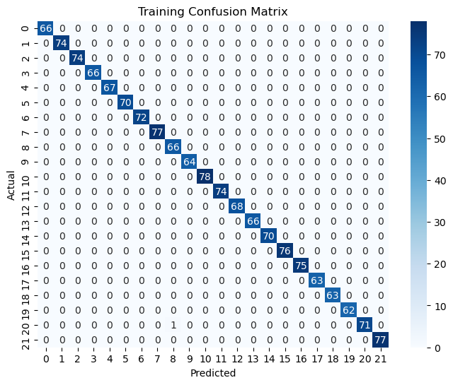
Model 2: Random Forest Results (Cont.)

Slide 27
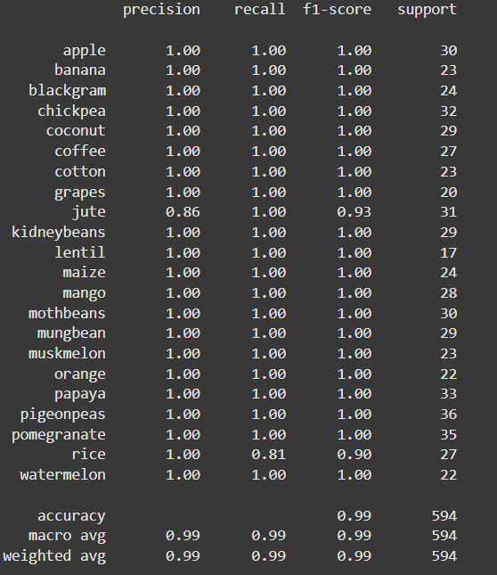
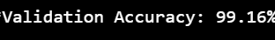
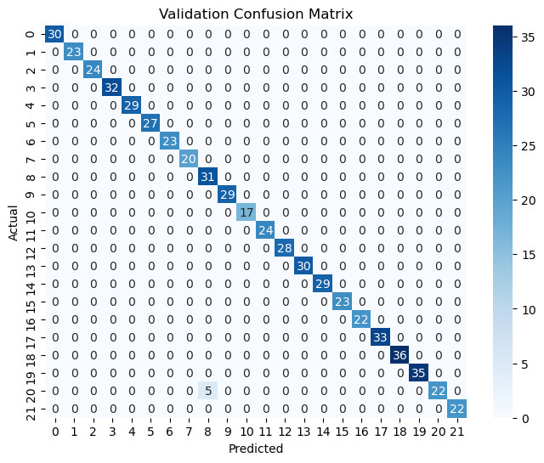
Model 2: Random Forest Results (Cont.)

Slide 28
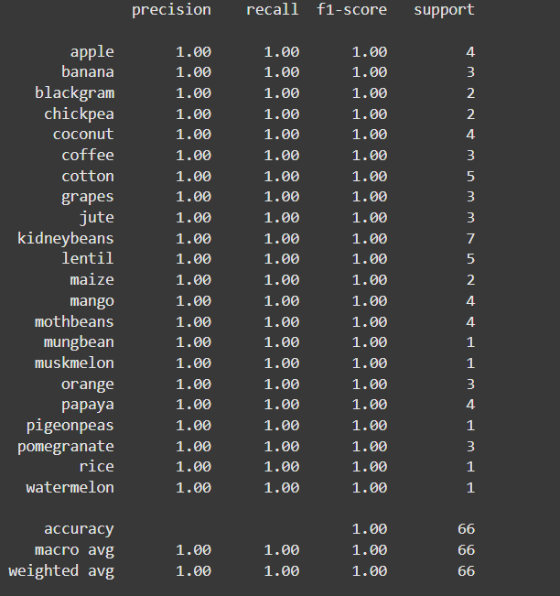
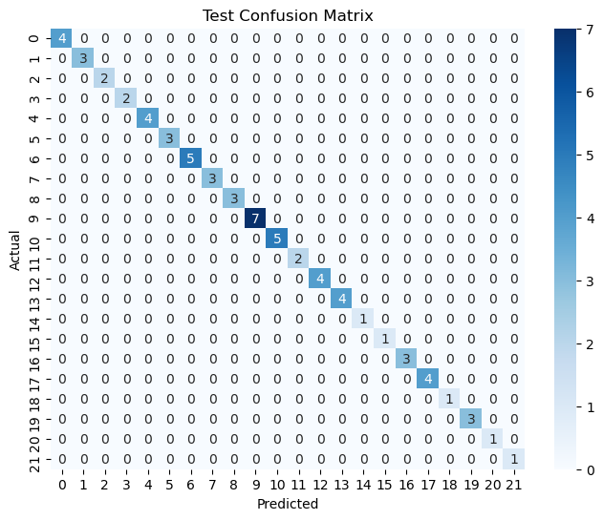
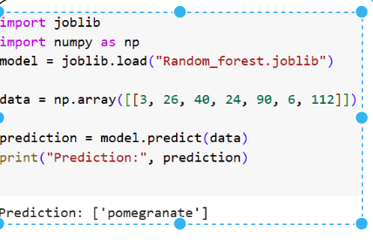
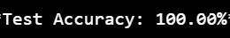
Model 2: Random Forest Results (Cont.)
Output

Slide 29

🌿 Feature 3: Fertilizer Recommendation
📊 Dataset Overview
Name: Crop and Fertilizer Recommendation Dataset
Size: 4,513 records
Key Features:
Soil and Environment: Nitrogen (N), Phosphorus (P), Potassium (K), pH, Rainfall, Temperature
Categorical Data: Soil Color (encoded numerically)
Target: Recommended Fertilizer type (multi-class classification)
Additional Fields: Recommended Crop.
Diversity: Data collected from multiple districts covering various geographical and climate conditions
🧠 Model Used: XGBoost
We selected XGBoost due to its:
High accuracy and efficiency
Excellent performance on imbalanced datasets
Built-in regularization that reduces overfitting and improves generalization
Split : 70% training - 20% validation - 10% testing

Slide 30
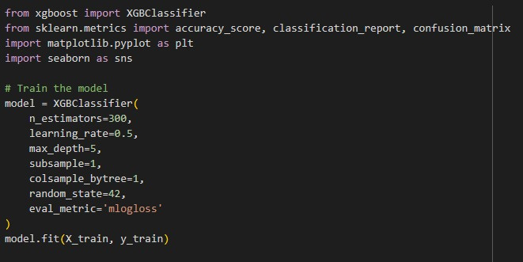
Model 3: XGBoost Results

Slide 31
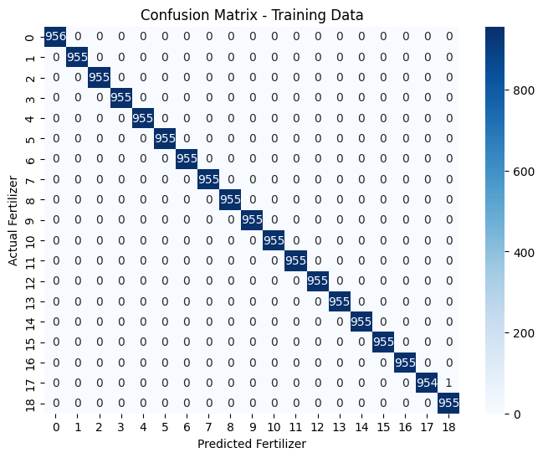
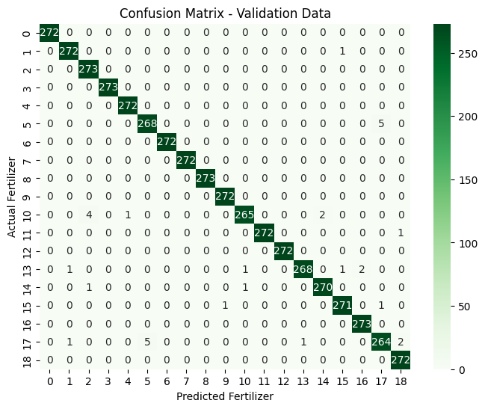


Model 3: XGBoost Results (Cont.)

Slide 32
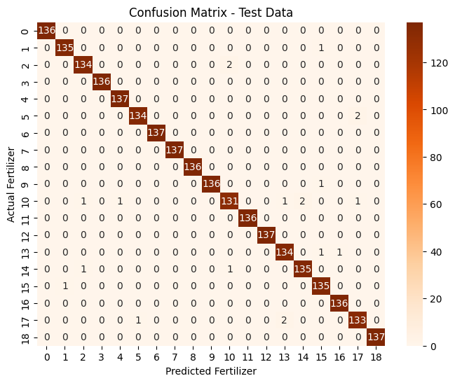
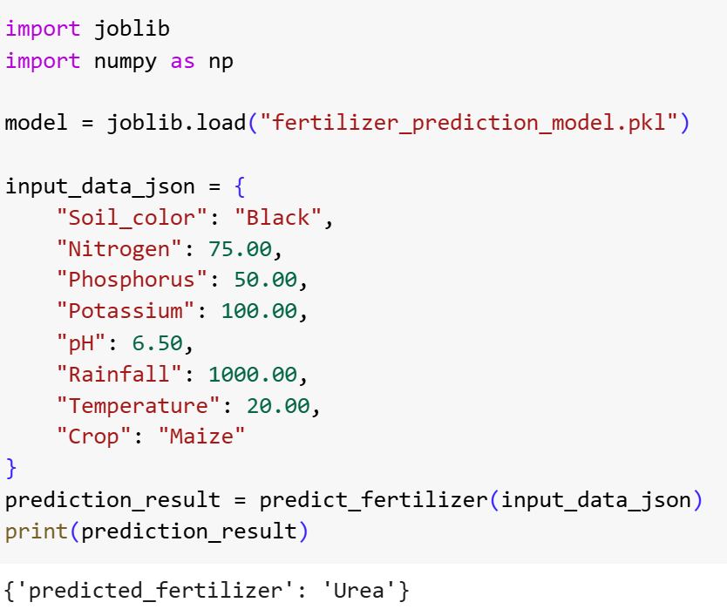
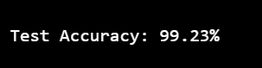
Model 3: XGBoost Results (Cont.)
Output

Slide 33
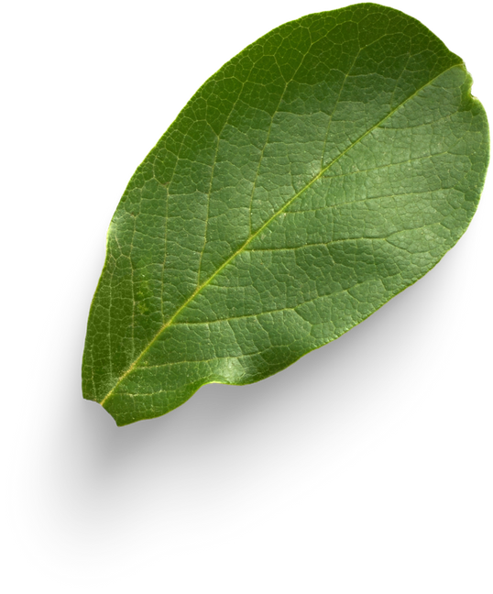
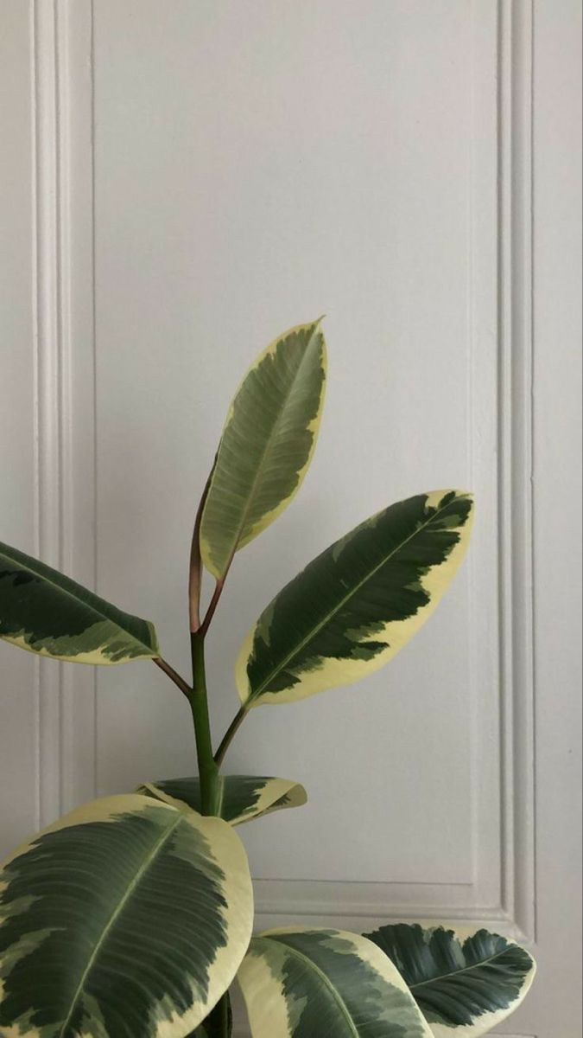
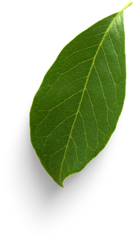


Demo of App
Some shots from our app
Light Mode
Dark Mode

Slide 34
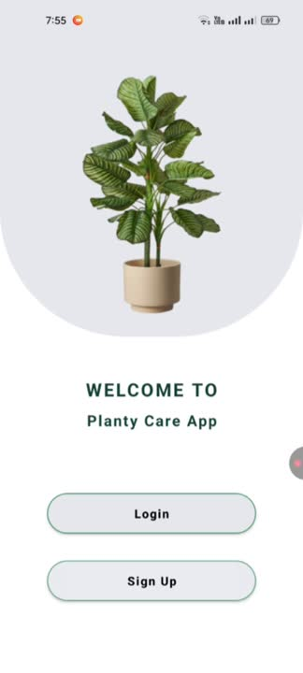
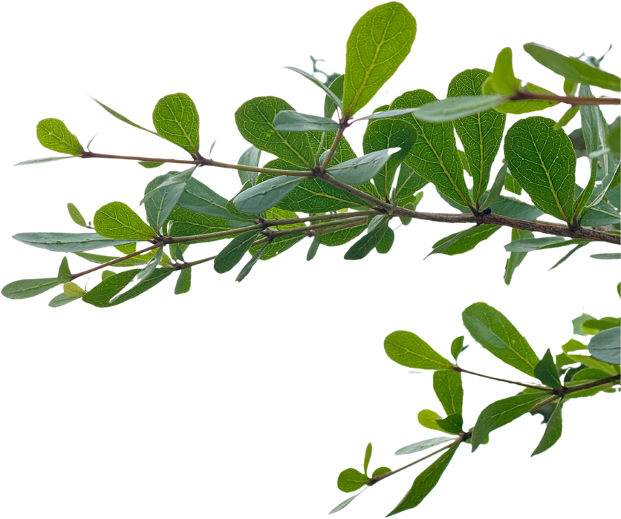
Demo of App Part 1
UI & Feature Overview
Video Link

Slide 35
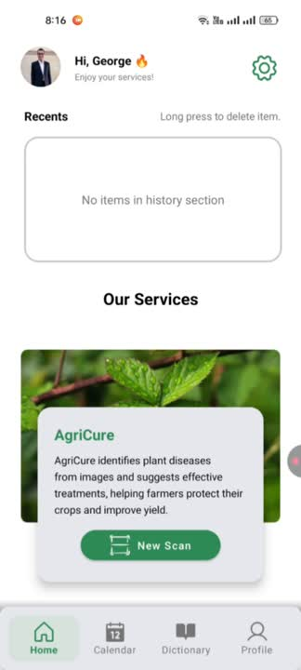
Demo of App Part 2
AI Models in Action
Video Link

Slide 36
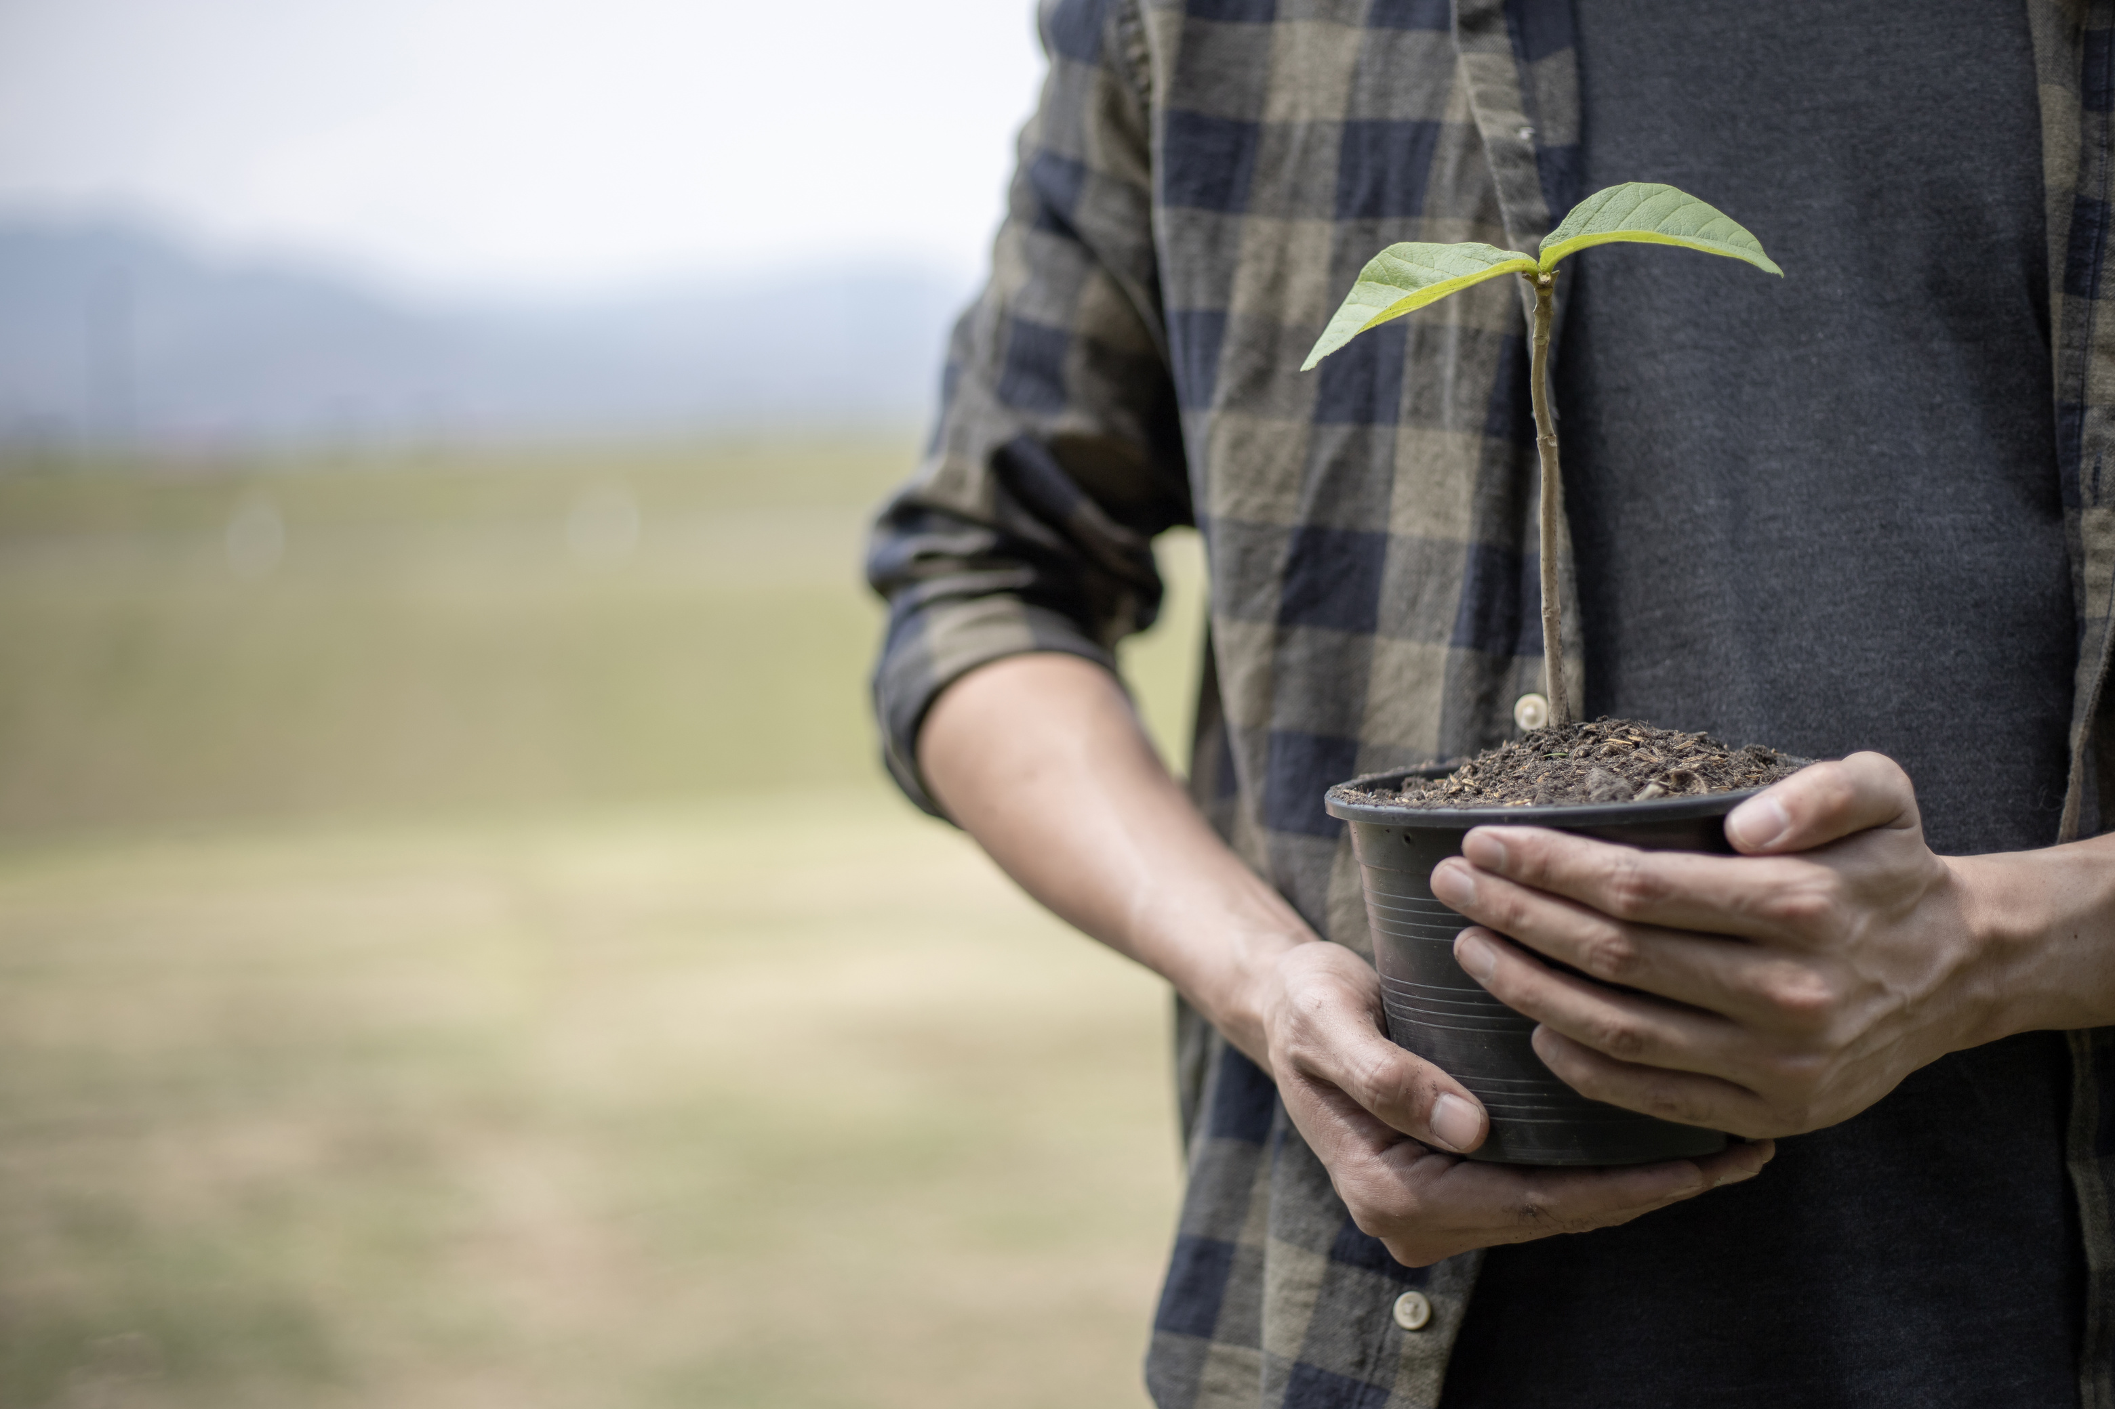
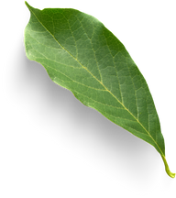


🌿 Future Improvements – Planty Care
Smart Sensor Integration: Real-time data from soil moisture, temperature, pH, and light sensors(IoT).
Real-time Image Scanning using Ai: Instant plant disease detection via camera — no manual uploads needed
Tracking Disease Progress with Growing Data: A system that keeps track of plant disease over time and works well even if more people use it.

Slide 37

Conclusion
Detects plant diseases using ResNet-50 (deep learning)
Recommends suitable crops via Random Forest model
Suggests optimal fertilizers using XGBoost algorithm
AI-powered mobile app for smart farming support
User-friendly, on-the-go access for farmers

Slide 38

Refernces
1) Bouacida, I., Farou, B., Djakhdjakha, L., Seridi, H., & Kurulay, M. (2025). Innovative deep learning approach for cross-crop plant disease detection: A generalized method for identifying unhealthy leaves. Information Processing in Agriculture, 12(1), 54-67.‏
2) Biswas, S., Saha, I., & Deb, A. (2024). Plant disease identification using a novel time-effective CNN architecture. Multimedia Tools and Applications, 83(35), 82199-82221.‏
3) Naveed, F., Masih, A., Mahmood, J., Ahmed, M., Ali, A., Saddiqa, A., ... & Agbozo, E. (2025). Sustainable AI for plant disease classification using ResNet18 in few-shot learning. Array, 26, 100395.‏

Slide 39

We hope you find our project valuable.
THANK YOU!
Repo github of our project

